Slide 1
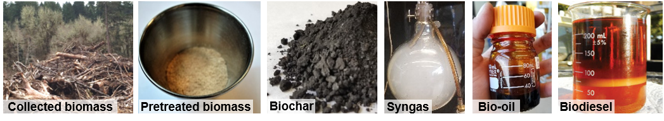
Biochar
Gas
Bio-oil

Slide 2
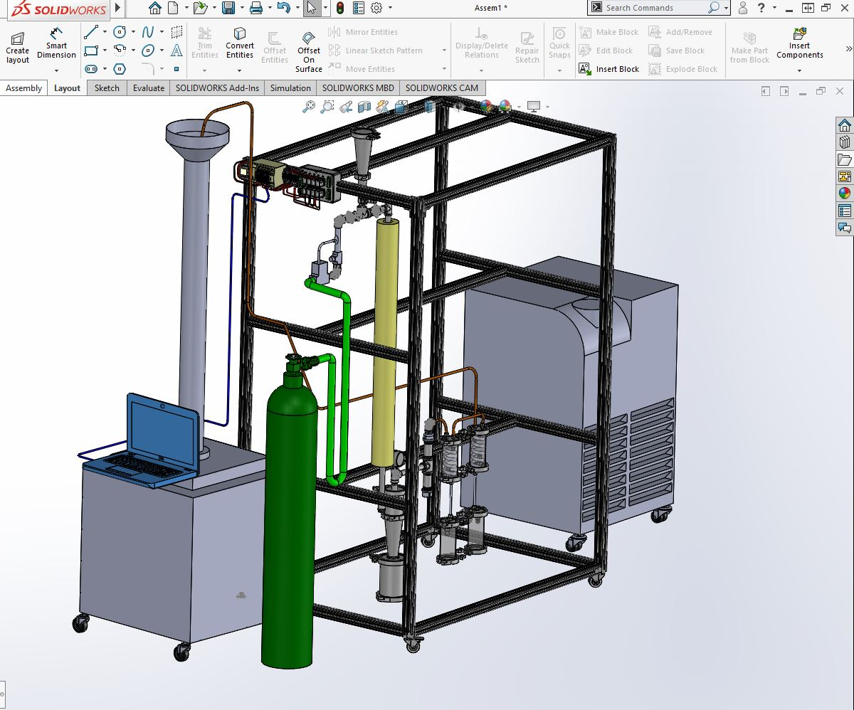
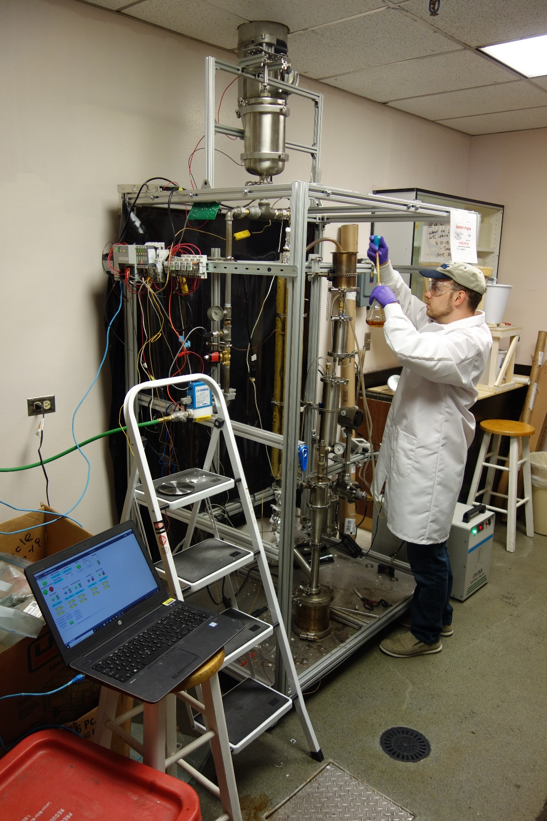
Pyrolysis setup

Slide 3
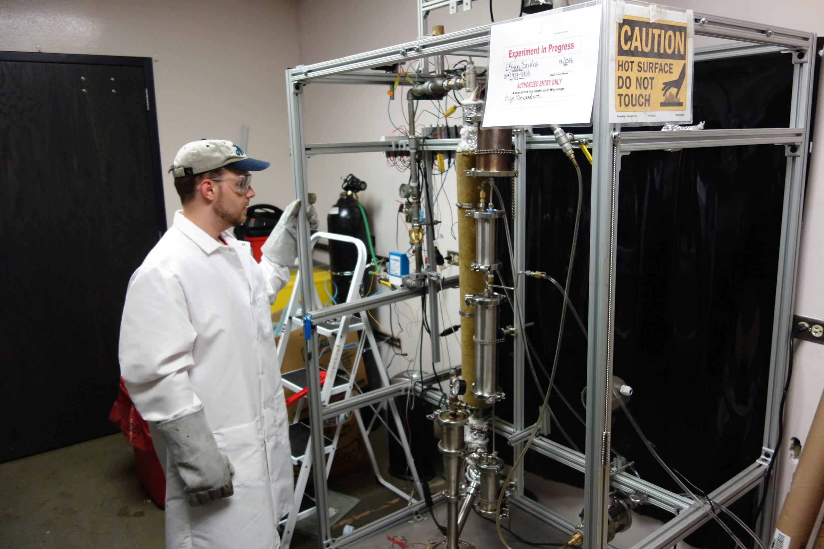
Mixed slow and fast pyrolysis apparatus

Slide 4
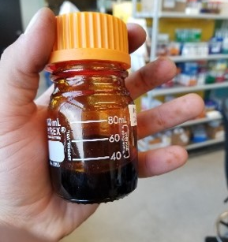
Untreated Bio-oil

Slide 5
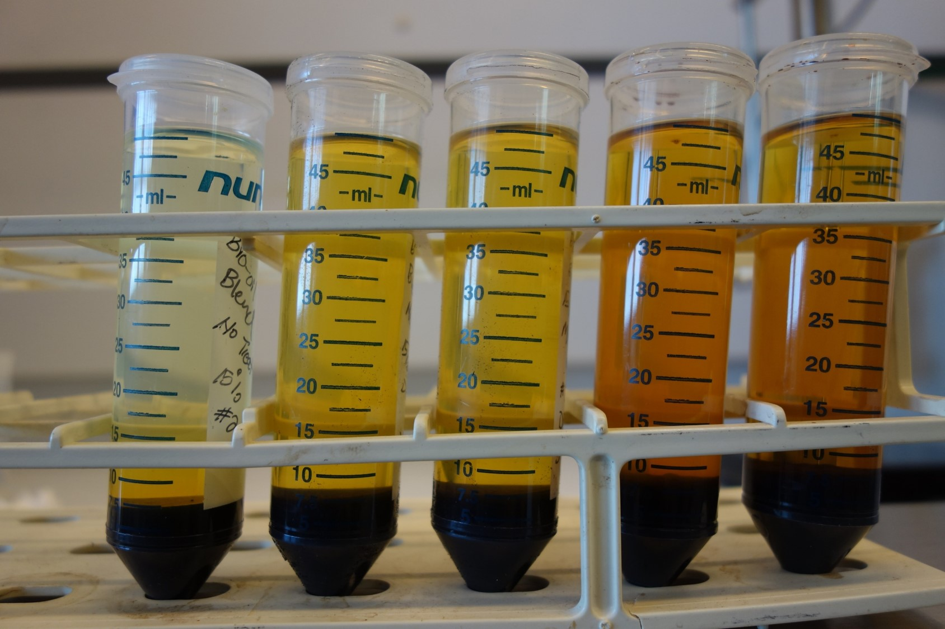
Blended Fuels

Slide 6
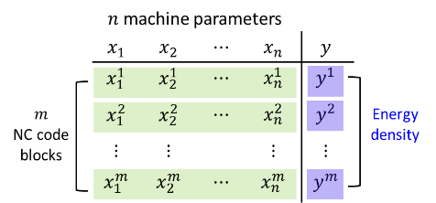
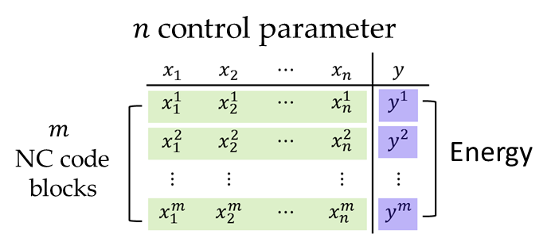




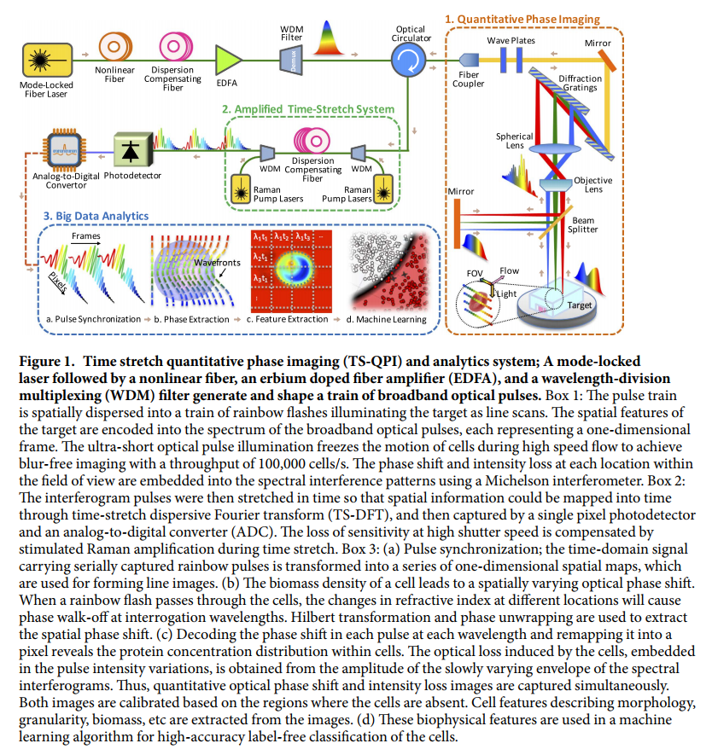


Training Dataset
Learning Algorithm
Predict Energy
x= Parameter inputs
y= Energy outputs
A = (x^{i},y^{i}) i=1,…,m
Find the weight for each parameters
Using ML techniques (e.g., SVM, ANN)
Predict energy used
Using the defined weights and inputs
X₂
Predict Total
Energy
Support Vectors
X₁
Measure & Analyze
Control & Improve
Devices:
DAQ
LabVIEW
Sensors
Data
Feedback
Cloud
Information Models
Algorithms & Analytics
Decision Makings
Resources:
Biomass
Catalyst
Gases
Power
Services:
Evaluation
Diagnostic
Detection
Prediction
Cooperative
Monitor Control
Machine
Learning
Physical Interface
Cyber Interface
Database
Data Training
Adaptivity

Slide 8

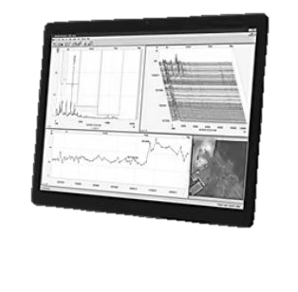
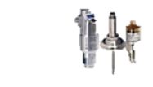
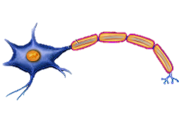
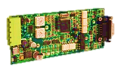
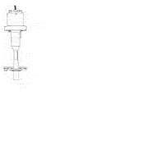

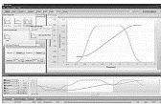
Physical Interface
Cyber Interface
Biomass
Intelligent
Monitoring
Module
ANN I/O Variables
Real-time Data
Condition Monitoring
Pre-Conversion
ANN Architecture
Machine Intelligence
ML: GFA or SVM
AI: ANN, CNN, or FLM
Actionable Knowledge:
understanding and predictions
CPS Control: data-driven DM and predictive analytics
Sensor Suitcase
Data Processing
Function: f(x)
Input Data
Inputs:
Potential,
Rate, Time,
Weight
Input-Output Module
Data Aggregation
Cell Body: Summation of weighted inputs and function
Outputs:
Action
Feedback
Data Decoder
Post-Conversion
Intelligent
Control
Module
Control Analyzer
Biofuels
Control Signals
Control Signals
Cyber-physical control and optimization platform for biofuel production

Slide 9
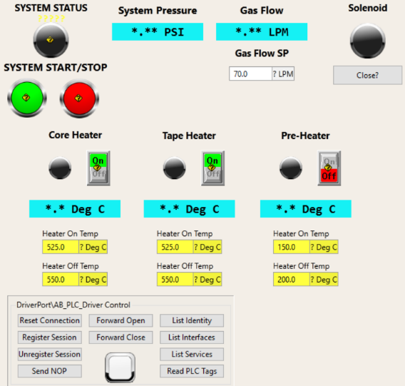
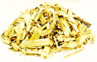
Human-machine interface

Slide 10
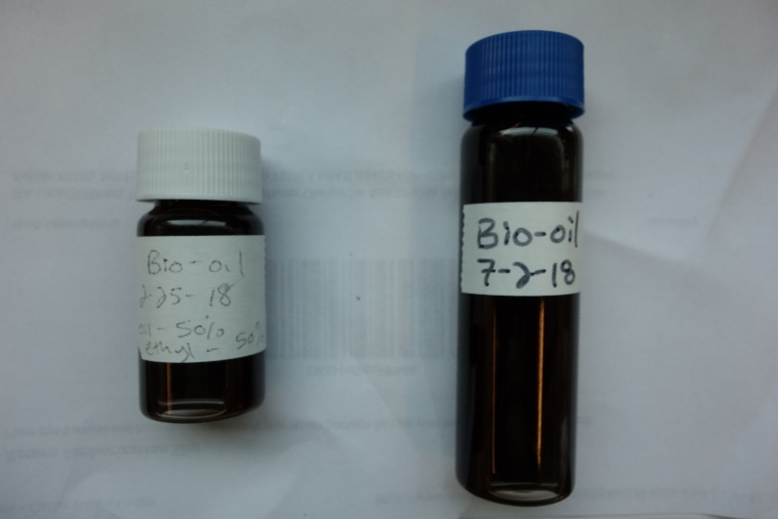
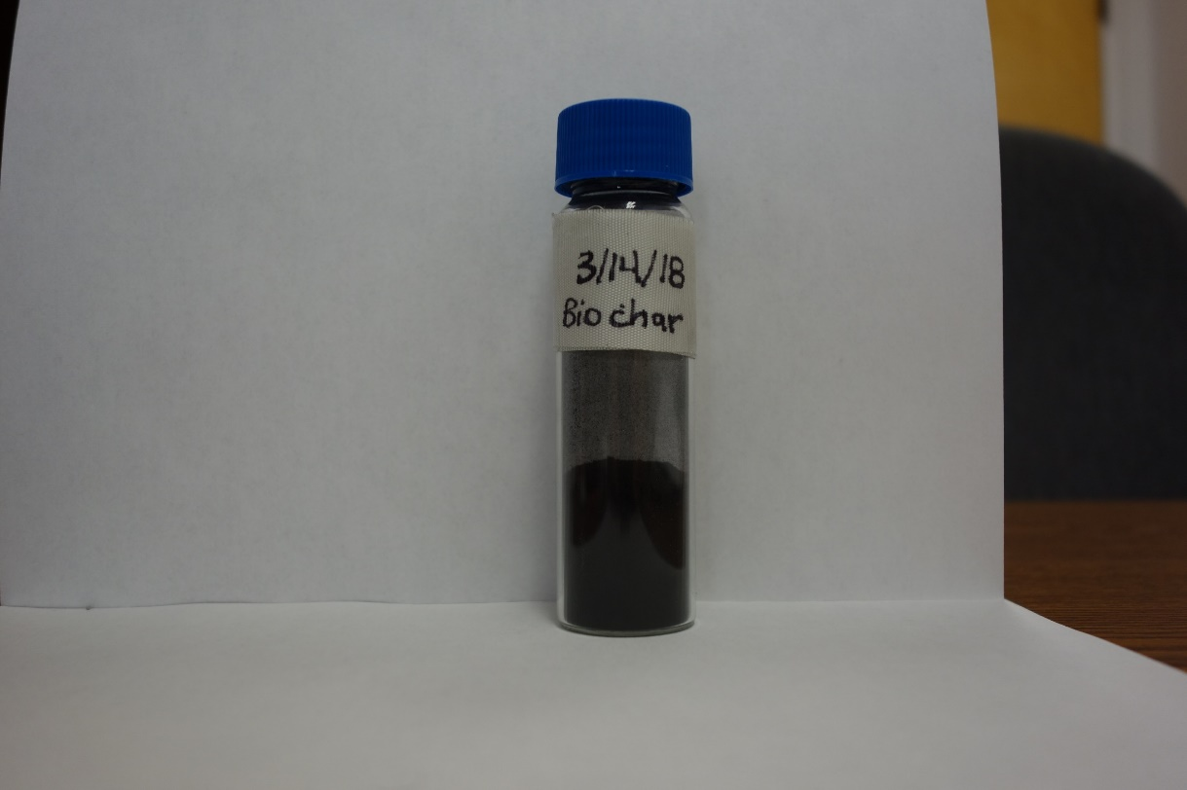

Slide 11
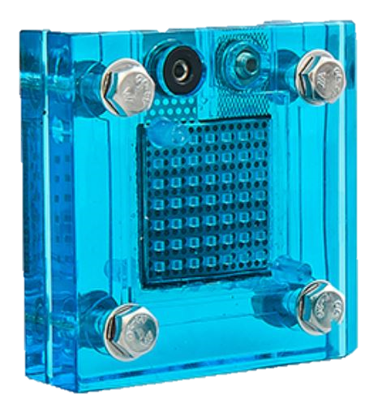
Electrolyzer

Slide 12
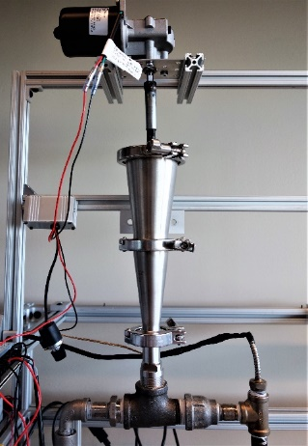
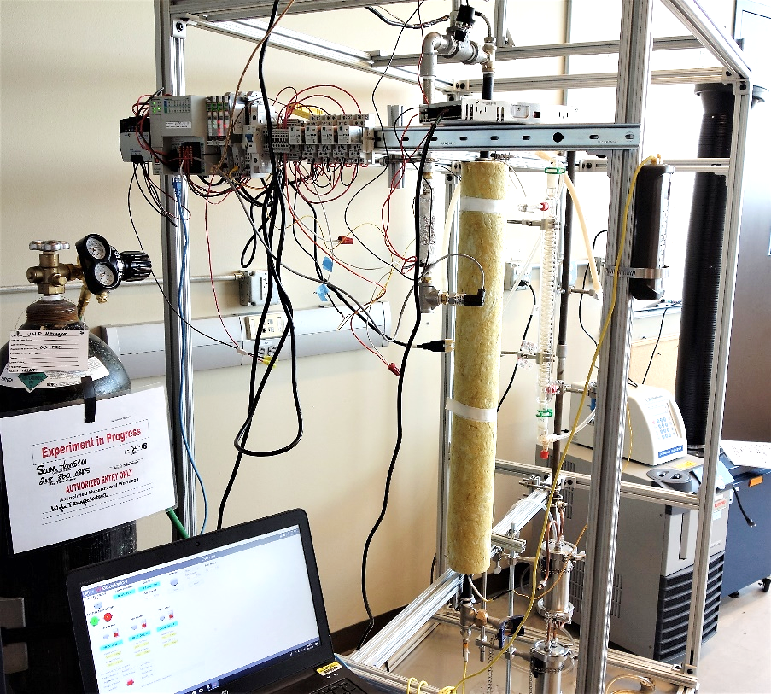
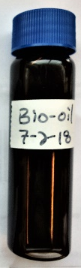
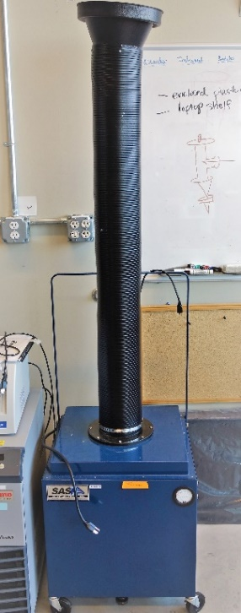
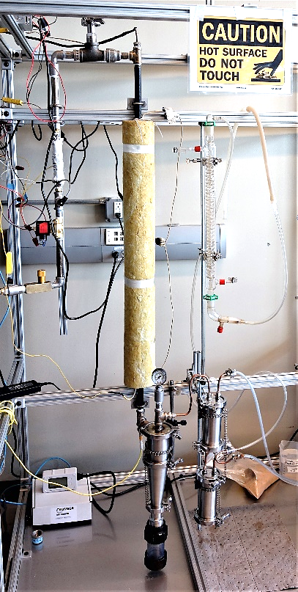
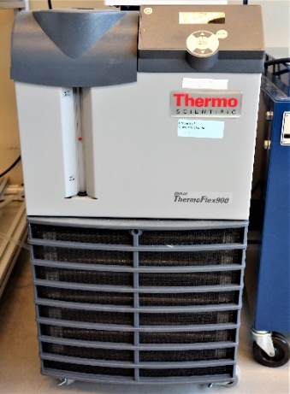
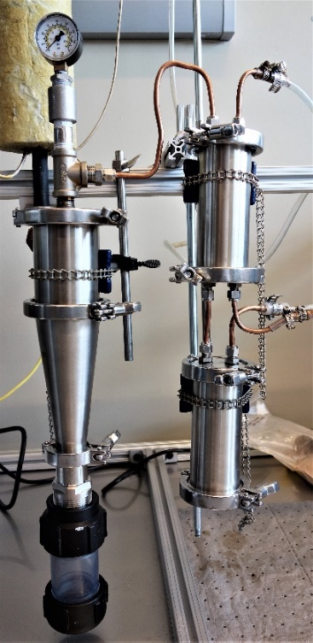
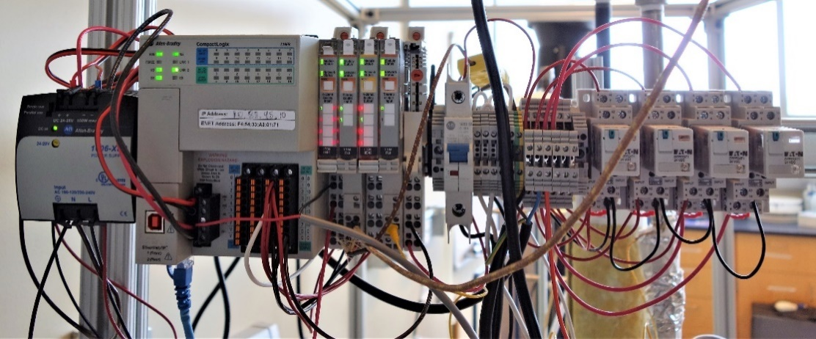
Designed and built in-house an entrained flow catalytic fast pyrolysis

Slide 13
PLC for controlling pyrolysis reactor

Slide 14
Chiller and portable fume hood

Slide 15
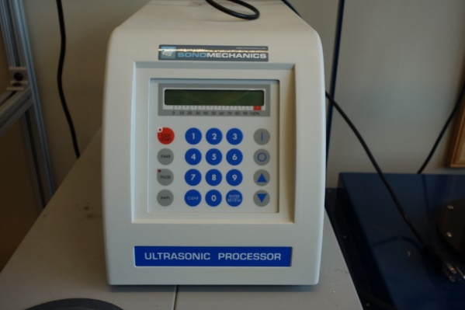
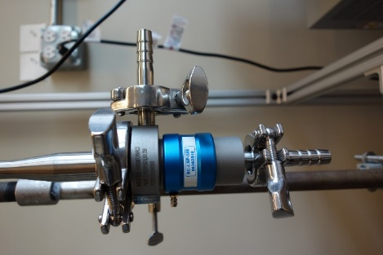
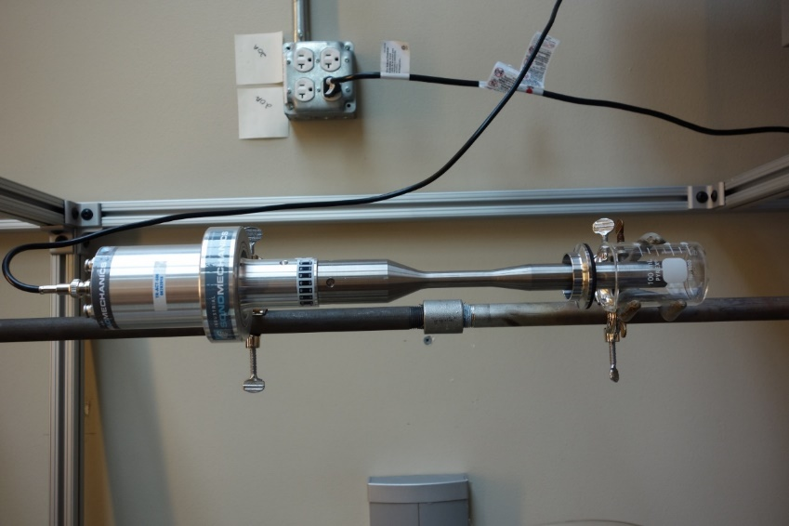
An Industrial Sonomechanics LSP 500 with full-wave barbell horn (FBH) and continuous flow-through configuration for upgrading untreated bio-oil samples via ultrasonic cavitation

Slide 16
Designed and built in-house a modular entrained flow catalytic fast pyrolysis, including auto feed system, PLC components, and produced bio-oil and biochar samples

Slide 17




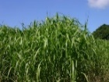
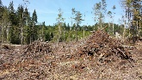
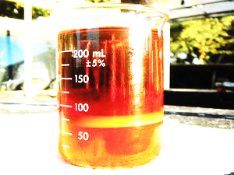

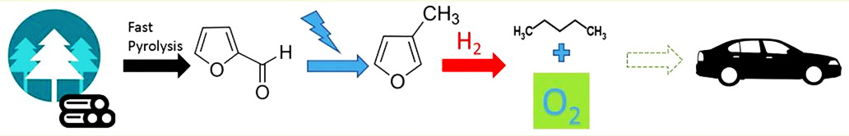

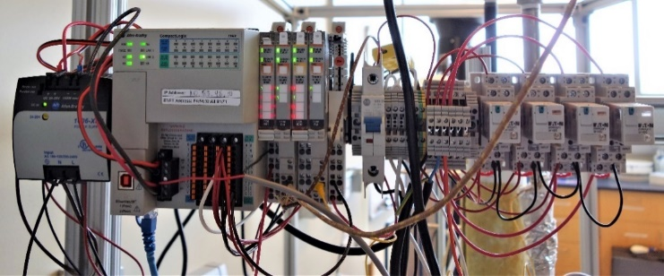

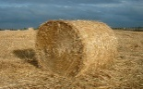
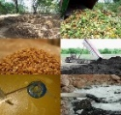








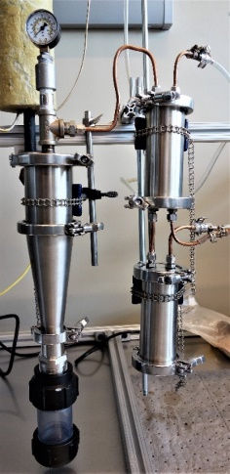
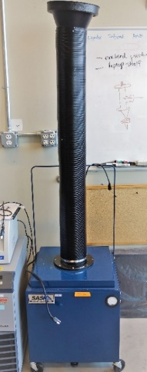

Internet of the Biofuel
Real-time communication
Collaborative systems
Data Acquisition
Connected process
Cloud-based storage
Biomass
Sources
(b)
(c)
(d)
(h)
Advanced Process
Multiple sensors
Remote operations
Real-time Assessments
Data analytics
Predictive analytics
(a)
(e)
(f)
(g)
(b)
(c)
(i)
Dr. Mirkouei and 2017 Students (Benjamin Hersh and Samual Hansen)
(a)

Slide 18


Slide 19













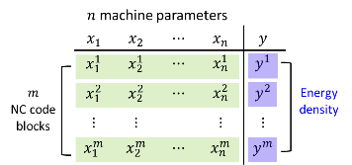
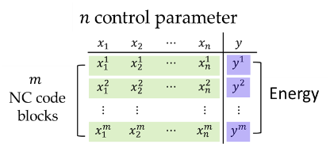
Measure & Analyze
Control & Improve
Devices:
DAQ
LabVIEW
Sensors
Data
Feedback
Cloud
Information Models
Algorithms & Analytics
Decision Makings
Resources:
Biomass
Catalyst
Gases
Power
Services:
Evaluation
Diagnostic
Detection
Prediction
Cooperative
Monitor Control
Machine
Learning
Physical Interface
Cyber Interface
Database
Data Training
Adaptivity
Physical Interface
Cyber Interface
Biomass
Intelligent
Monitoring
Module
ANN I/O Variables
Real-time Data
Pre-Conversion
Condition Monitoring
ANN Architecture
Machine Intelligence
ML: GFA or SVM
AI: ANN, CNN, or FLM
Actionable Knowledge:
understanding and predictions
CPS Control: data-driven DM and predictive analytics
Sensor Suitcase
Data Processing
Function: f(x)
Input-Output Module
Input Data
Inputs:
Potential,
Rate, Time,
Weight
Cell Body: Summation of weighted inputs and function
Outputs:
Action
Feedback
Data Aggregation
Post-Conversion
Data Decoder
Intelligent
Control
Module
Biofuels
Control Analyzer
Control Signals
Control Signals
Data Acquisition & Processing
Sensor Suitcase
Controllers
External Sensors
Data Agent
Generator
Processor
Simulator
Compiler
Knowledge Agent
Data Analysis
Prediction Models
Knowle. Archive
Firewall-protected Local Network
Process, Sensors, PLC, & Actuators
Adaptive Machine Learning
I-O*
Data
I-O
Data
Web Service
Public
Private
Continuous Monitoring & Control
Target Operation
Cat. Fast Pyrolysis
Internal Sensors
I-O
Data
Time Buffer
* Input-Output
Training Dataset
Learning Algorithm
Predict Energy
x= Parameter inputs
y= Energy outputs
A = (x^{i},y^{i}) i=1,…,m
Find the weight for each parameters
Using ML techniques (e.g., SVM, ANN)
Predict energy used
Using the defined weights and inputs
X₂
Predict Total
Energy
Support Vectors
X₁

Slide 20
MAKE A GIFT
To IDeaL

Slide 21
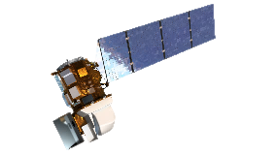
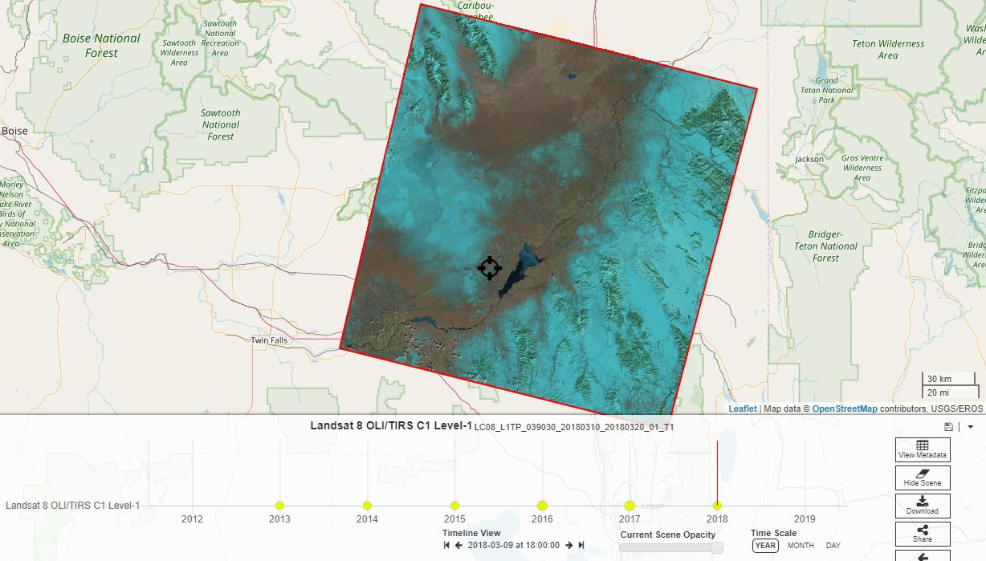



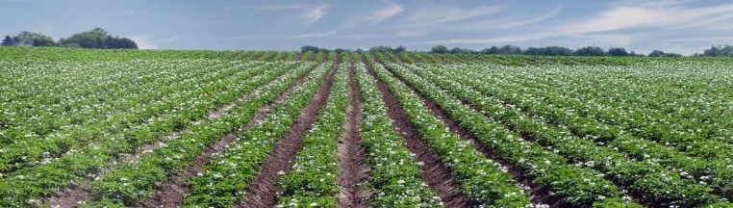
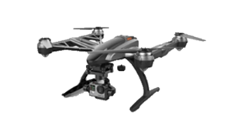
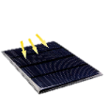


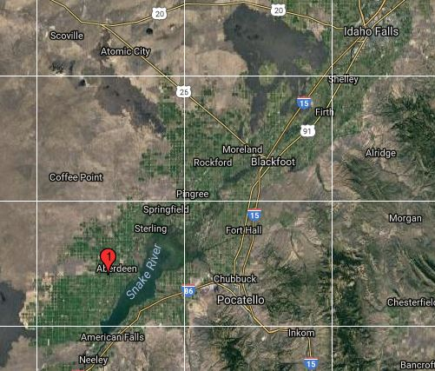

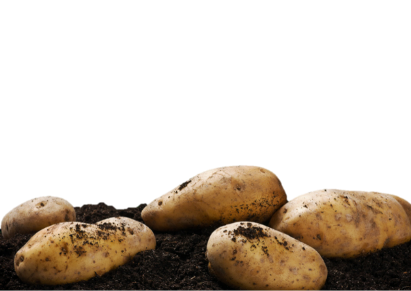
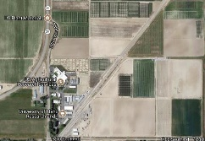













Aberdeen Research and Extension Center
Task 1. Standardization of analytical techniques
Analytical steps fact sheets
Observation guidelines
Physical (density, stability)
Chemical (pH, nitrate)
Biological (organic matter)
Test procedures guidelines
Indicators (properties)
Metrics (productivity)
Tools (test kit)
Field-scale interpretive guides
Diagnose soil needs
Match nutrient supply
Data and knowledge agent
Task 2. Data-driven decision support system
DFFNN and stochastic gradient descent approach
App and network services
Real-time soil data
Proactive measures
Insights, alerts, and sharing
Task 3. Soil-crop quality assessments
Sensor integration
Wireless - low energy communication
On-board NPK, temp., and moisture sensors
3.3 V voltage regulator
Sustainability assessment
$\operatorname{Min}{Obj}. 1$,$Max Obj. 2$
s.t.
$β.μi+(β.{σi}^{2})φ^{−1}≤$ $quality$
$$β.μj+(β.{σj}^{2})φ^{−1}≤timing$$
$$\text{Product} \text{Yield}=W.quality$$
PC
Tablet
Phone
Training datasets
Service Bus
Access Control
Data Sync
SeDS Show More
Learning
algorithm
Data App Integ. Client
Soil Health Metric
Layers
Web Role
Worker Role
VM Role
Alert - Aberdeen Field-3 has two critical issues
Recommendations…
Tables
Caching
Hypotheses f(x)

Slide 22

Proposed Biomass-to-Bioenergy Supply Chain (B2BSC)

Slide 23

Biomass-to-Bioenergy Supply Chain Segments and Pyrolysis Conversion Process

Slide 24


Slide 25

Dr. Mirkouei and 2017 Students (Benjamin Hersh and Samual Hansen)

Slide 26


Slide 27

Dr. Mirkouei and 2018 Students (Benjamin Hersh, Samual Hansen, Darpan Shah, Scott Ashby, and Chadron Ryan)

Slide 28

Lab-scale Pyrolysis Apparatus
Chadron Ryan, Samual Hansen, Benjamin Hersh, Scott Ashby, Dr. Mirkouei, and Darpan Shah

Slide 29

Dr. Mirkouei received Design for Manufacturing and the Life Cycle Scholar Award from ASME Conference, (08/2016)

Slide 30

Dr. Mirkouei received IE Outstanding Graduate Teaching Assistant Award, School of MIME, OSU, (05/2015)

Slide 31

Sam Hansen’s Thesis Defense – August 16, 2019

